Slide 1

Dr. Max Mustermann Referat Kommunikation & Marketing Verwaltung
Estimating valence from self-stimulating paradigms
Christian Rohrsen
Institute of Zoology – Neurogenetics

Slide 2

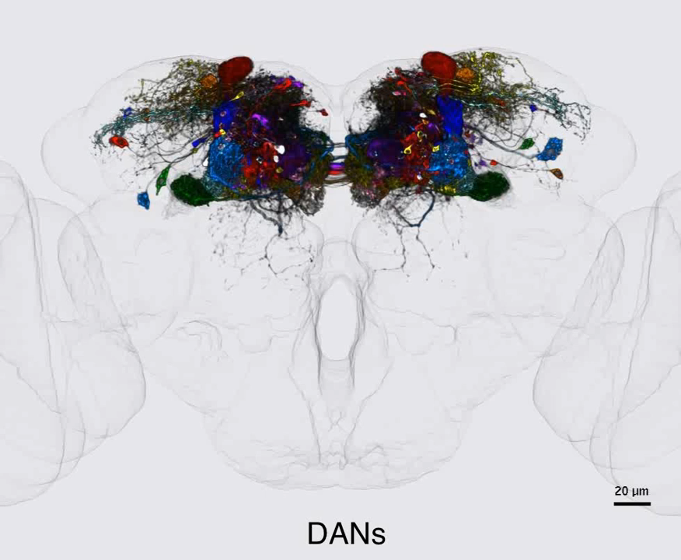
Dopaminergic neurons projecting to the MB

Slide 3

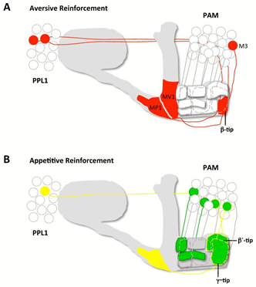
Dopaminergic neurons projecting to the MB
Notes:
Reward is the attractive and motivational property of a stimulus that induces appetitive behavior – also known as approach behavior – and consummatory behavior.
Valence, as used in psychology, especially in discussing emotions, means the intrinsic attractiveness/"good"-ness (positive valence) or averseness/"bad"-ness (negative valence) of an event, object, or situation.^{[1]} The term is also used to characterize and categorize specific emotions. For example, the emotions popularly referred to as "negative", such as anger and fear, have "negative valence". Joy has "positive valence". Positively valenced emotions are evoked by positively valenced events, objects, or situations. The term is also used to describe the hedonic tone of feelings, affect, certain behaviors (for example, approach and avoidance), goal attainment or nonattainment, and conformity with or violation of norms. Ambivalence can be viewed as conflict between positive and negative valence-carriers.^{[citation needed]}
In its description of a rewarding stimulus (i.e., "a reward"), a review on reward neuroscience noted, "any stimulus, object, event, activity, or situation that has the potential to make us approach and consume it is by definition a reward."^{[1]} In operant conditioning, rewarding stimuli function as positive reinforcers;^{[1]} however, the converse statement also holds true: positive reinforcers are rewarding.^{[1]}

Slide 4
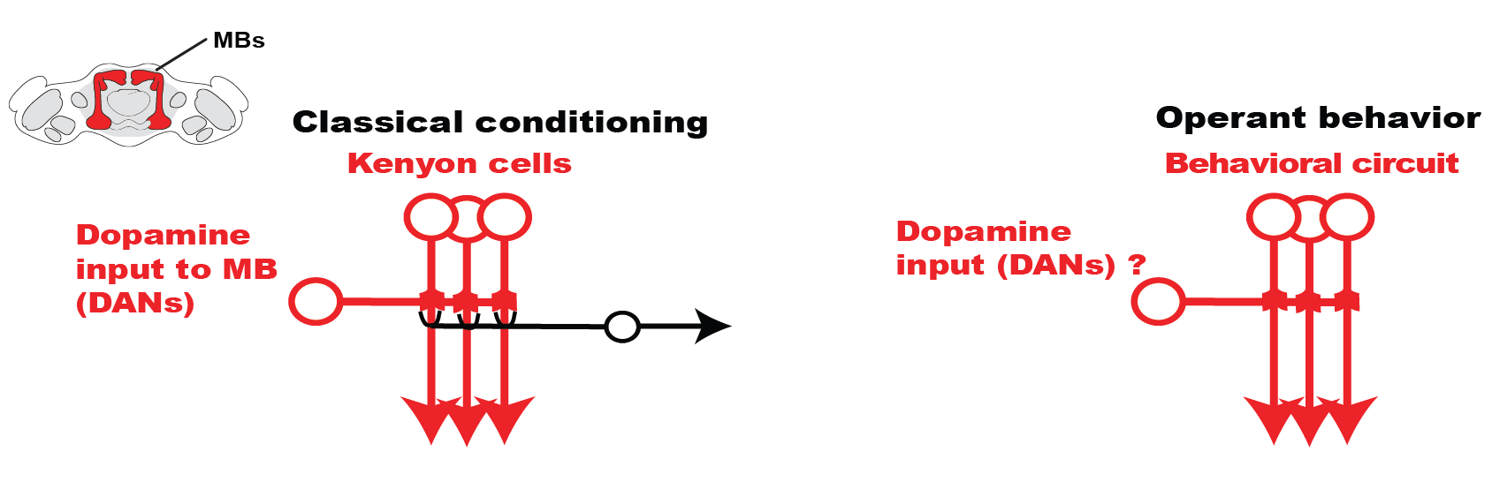
Is dopamine reinforcing operantly so as it rewards
in classical paradigms?

Slide 5
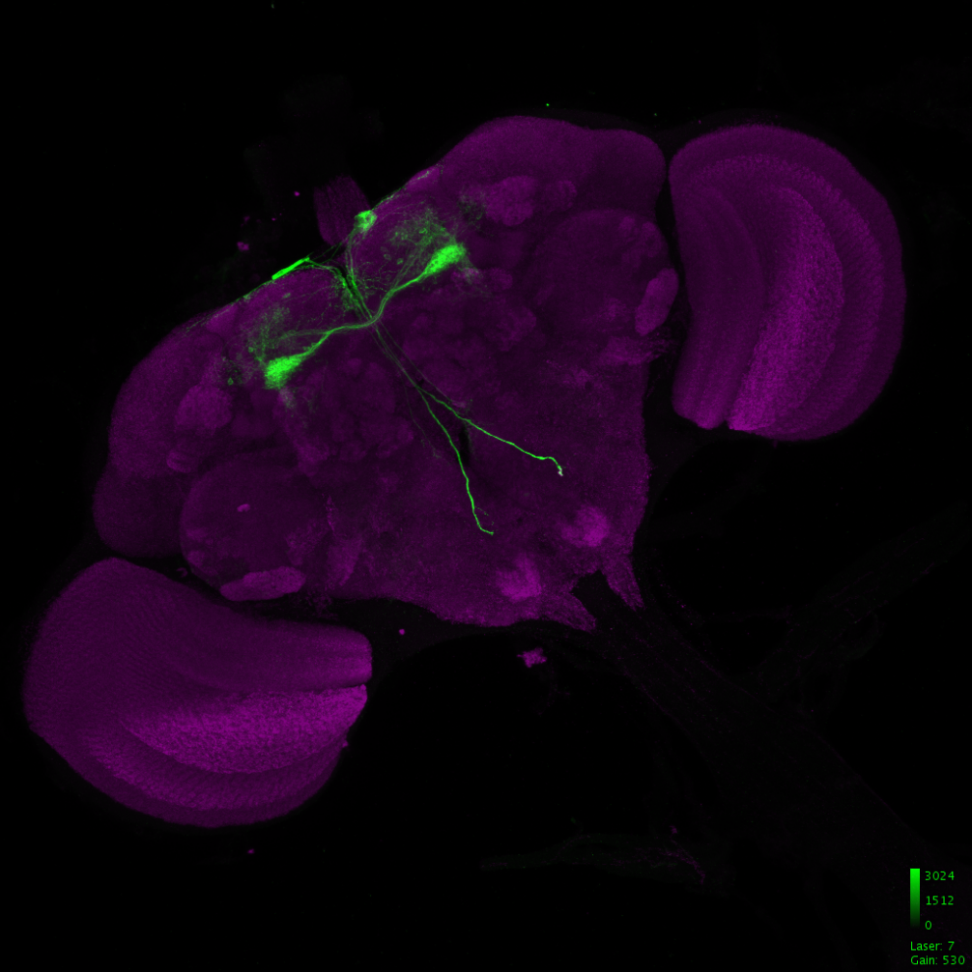
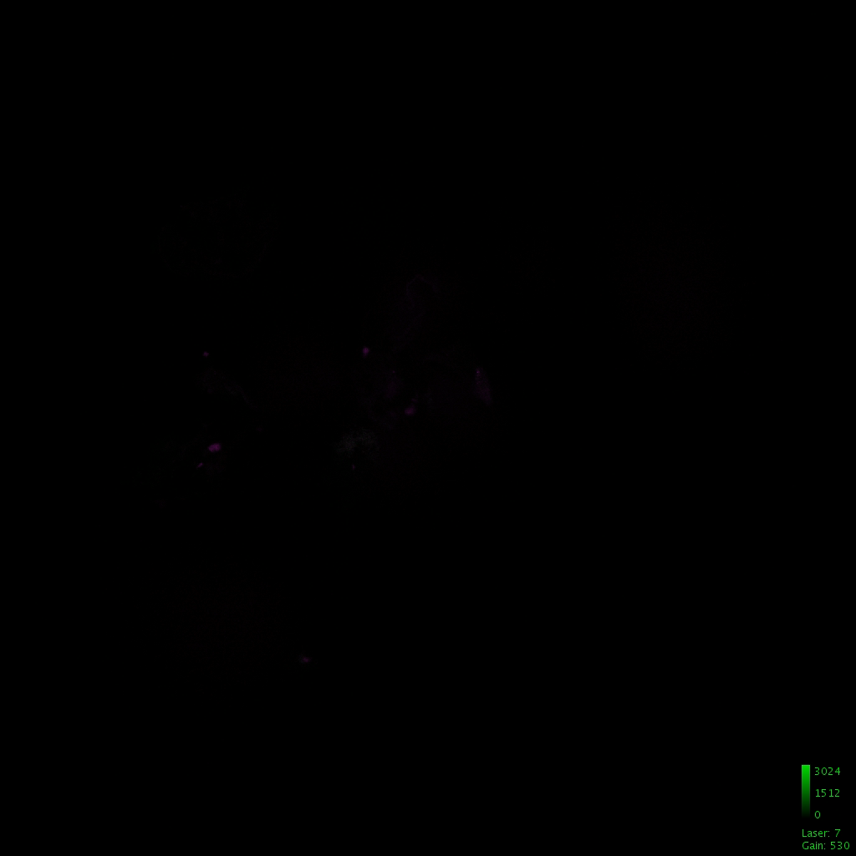
Split-G4s to express specifically in dopaminergic
neurons
MB025B-G4

Slide 6
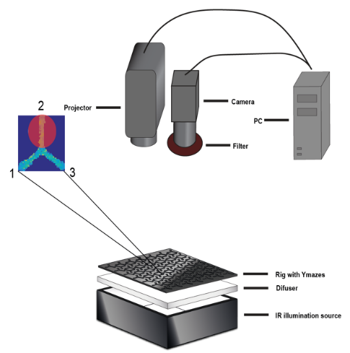
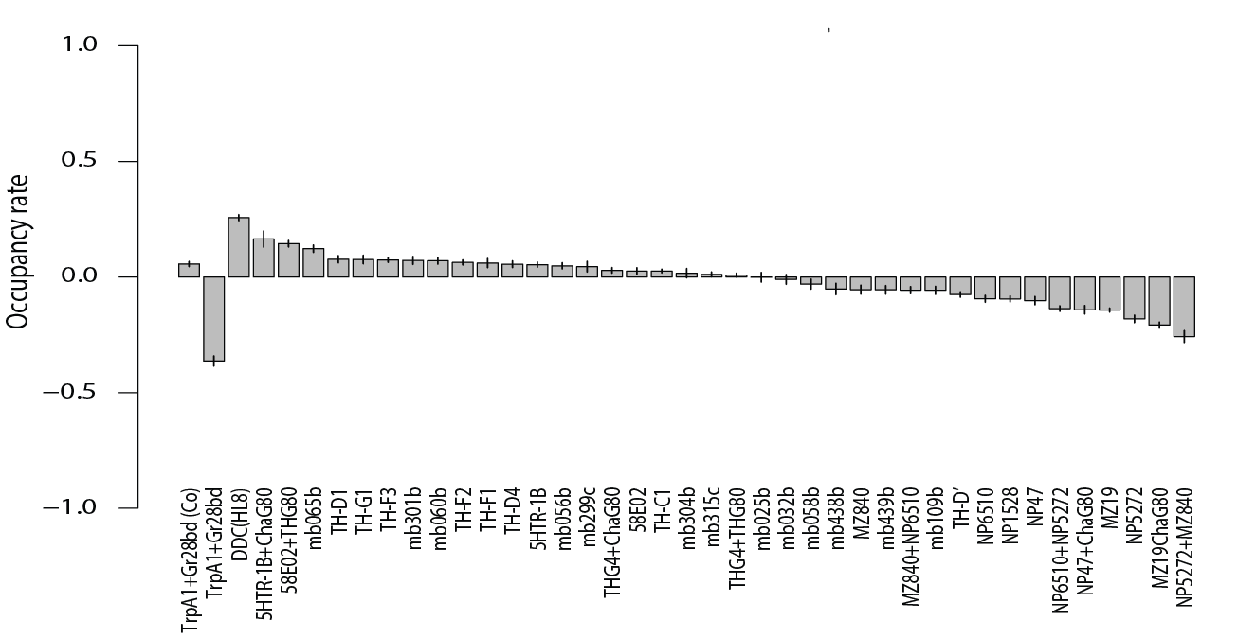
Behavioral measurements

Slide 7

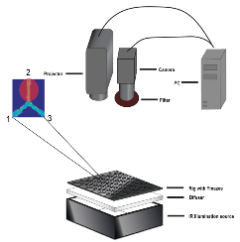
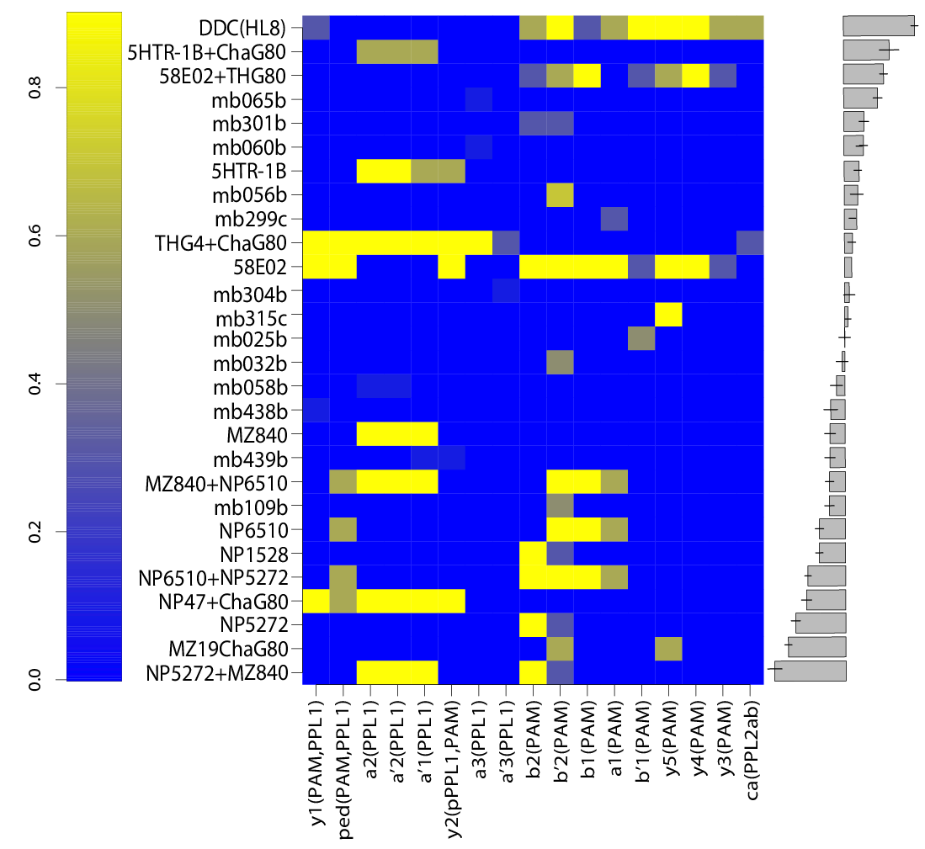


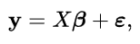
Scores-expression correlations

Slide 8
Estimating valences
TH-G4
Expression level at α2(PPL1)
Expression level at cluster p
PI contribution of α2(PPL1)
PI contribution of cluster p
PI (TH-G4)

Slide 9
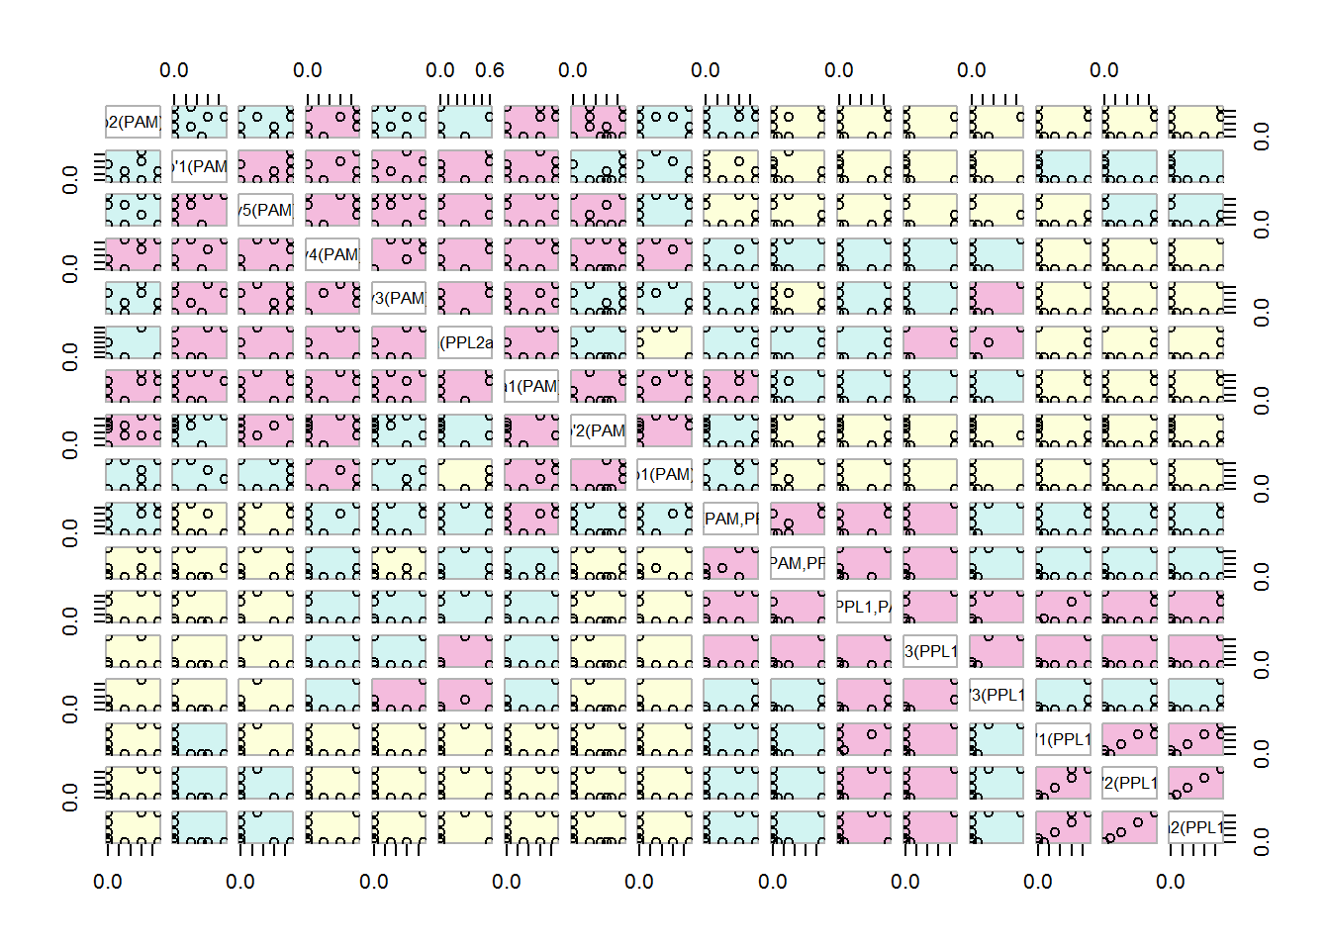
Clusters are often expressed together

Slide 10

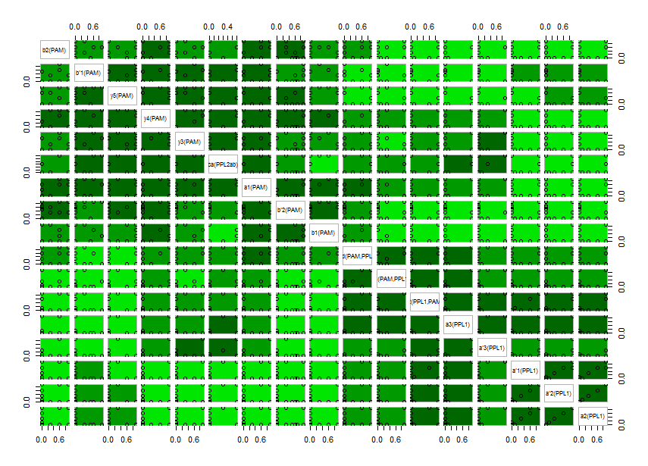
Principal Component Analysis: using correlations
for reducing dimensions
PC1
PC2
PC3

Slide 11
Expression correlations to reduce dimensions

Slide 12
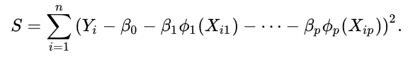
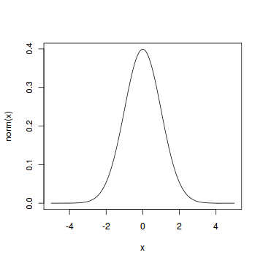
Generalized additive model
TH-G4
Contribution to behavioral scores is not anymore proportional to the expression level
Optimization by least squares
Expression level at α2(PPL1)
Expression level at cluster p
PI contribution of α2(PPL1)
PI contribution of cluster p
PI (TH-G4)
Nonlinearities: splines in the case of GAMs

Slide 13
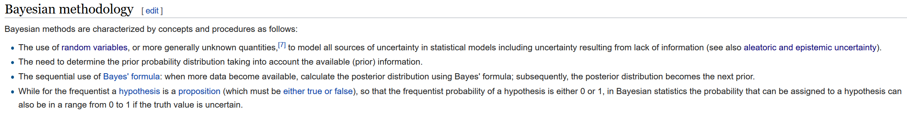
Bayesian statistics

Slide 14
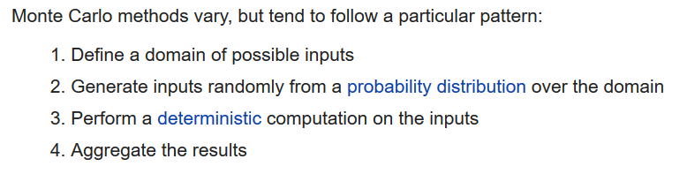
Monte Carlo methods

